Slide 1
ENGT 3510
Welcome to
Advanced Statistics in Engineering Technology
Introduction

Slide 2
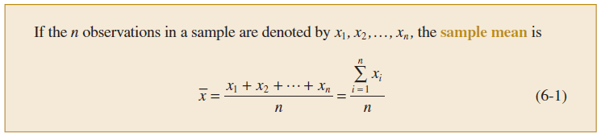
Mean
Characterize the location or central tendency in the data is represented by the ordinary arithmetic average or mean.
We almost always think of our data as a sample.

Slide 3
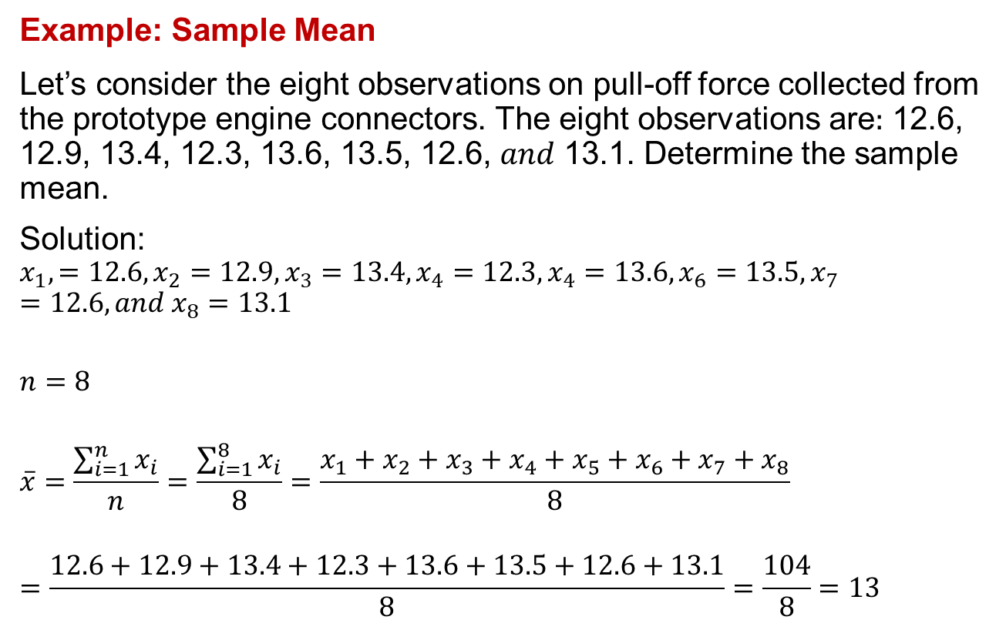
Mean
Example: Sample Mean
Let’s consider the eight observations on pull-off force collected from the prototype engine connectors. The eight observations are$:$ 12.6, 12.9, 13.4, 12.3, 13.6, 13.5, 12.6, 𝑎𝑛𝑑 13.1. Determine the sample mean.
Solution:
$$x_{1},=12.6, x_{2}=12.9, x_{3}=13.4, x_{4}=12.3, x_{4}=13.6, x_{6}=13.5, x_{7}=12.6, and x_{8}=13.1$$
$$n=8$$
$$\overline{x}=\frac{\sum_{i=1}^{n}{x_{i}}}{n}=\frac{\sum_{i=1}^{8}{x_{i}}}{8}=\frac{x_{1}+x_{2}+x_{3}+x_{4}+x_{5}+x_{6}+x_{7}+x_{8}}{8}$$
$$=\frac{12.6+12.9+13.4+12.3+13.6+13.5+12.6+13.1}{8}=\frac{104}{8}=13$$

Slide 4
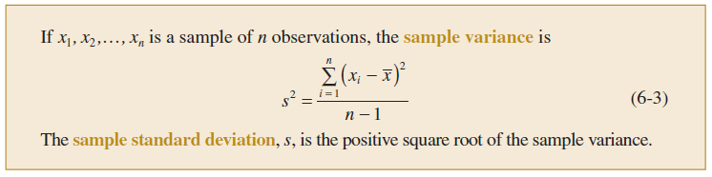
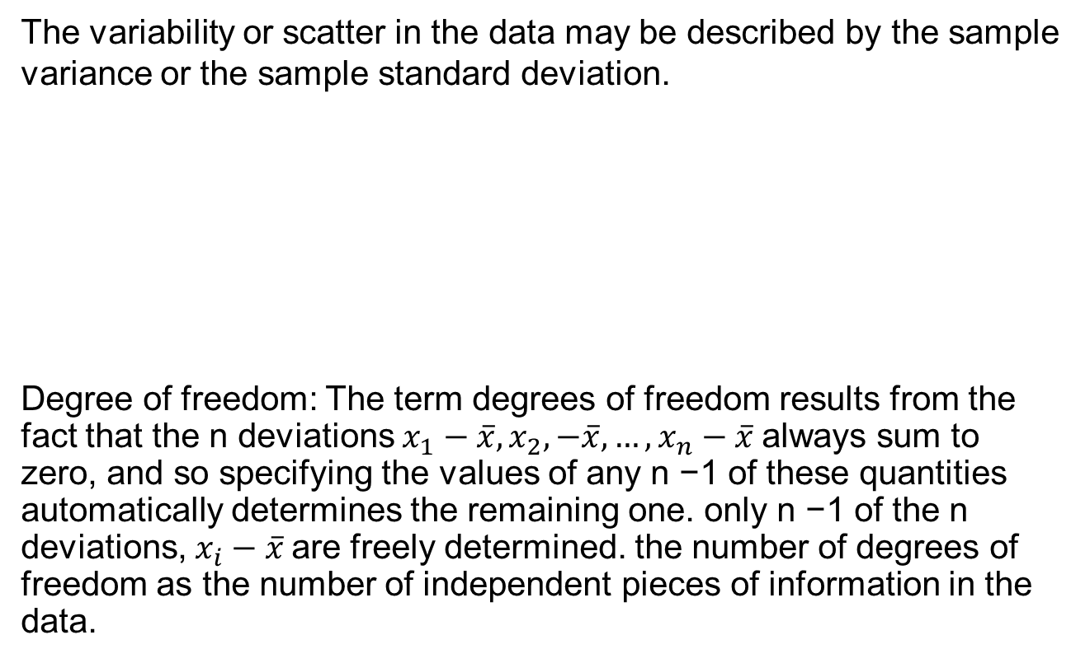
Variance
The variability or scatter in the data may be described by the sample variance or the sample standard deviation.
Degree of freedom: The term degrees of freedom results from the fact that the n deviations $x_{1}−\overline{x}, x_{2},−\overline{x},…,x_{n}−\overline{x}$always sum to zero, and so specifying the values of any n −1 of these quantities automatically determines the remaining one. only n −1 of the n deviations, $x_{i}−\overline{x}$are freely determined. the number of degrees of freedom as the number of independent pieces of information in the data.

Slide 5

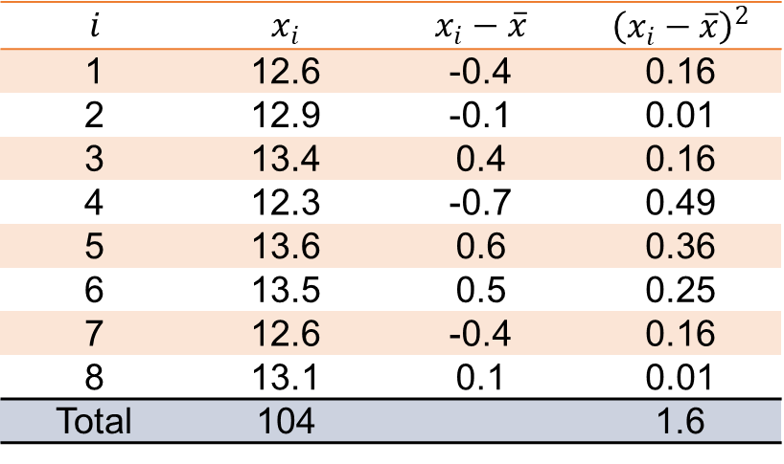
Variance
Example
Let’s consider the eight observations on pull-off force collected from the prototype engine connectors. The eight observations are$:$ 12.6, 12.9, 13.4, 12.3, 13.6, 13.5, 12.6, 𝑎𝑛𝑑 13.1. Determine the sample variance and standard deviation.
$$\overline{x}=\frac{104}{8}=13$$
$$i$$ | $$x_{i}$$ | $$x_{i}−\overline{x}$$ | $${\left(x_{i}−\overline{x}\right)}^{2}$$
1 | 12.6 | -0.4 | 0.16
2 | 12.9 | -0.1 | 0.01
3 | 13.4 | 0.4 | 0.16
4 | 12.3 | -0.7 | 0.49
5 | 13.6 | 0.6 | 0.36
6 | 13.5 | 0.5 | 0.25
7 | 12.6 | -0.4 | 0.16
8 | 13.1 | 0.1 | 0.01
Total | 104 |  | 1.6

Slide 6

Variance
Example (continued)
$${variance,s}^{2}=\frac{\sum_{i=1}^{n}{{\left(x_{i}−\overline{x}\right)}^{2}}}{n−1}=\frac{\sum_{i=1}^{8}{{\left(x_{i}−\overline{x}\right)}^{2}}}{8−1}=\frac{1.6}{7}=0.2286$$
$$standard deviation, s=\sqrt{s^{2}}=\sqrt{0.2286}=0.48$$

Slide 7
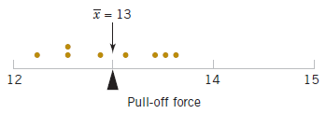
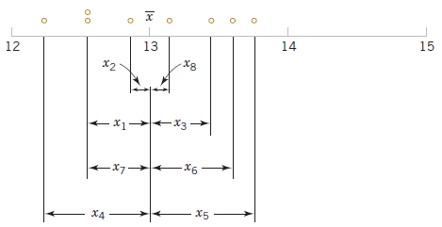
Variance
How the sample variance measures variability
From the example

Slide 8

Variance
Population variance
It is analogous to sample variance.

Slide 9
Frequency Distributions and Histograms
A frequency distribution is a compact summary of data.
Divide the range of the data into intervals (cells and bins)
The bins should be of equal width in order to enhance the visual information in the frequency distribution.
Several sets of rules can be used to determine the member of bins in a histogram. However, choosing the number of bins approximately equal to the square root of the number of observations often works well in practice.
The relative frequencies are found by dividing the observed frequency in each bin by the total number of observations.

Slide 10
Frequency Distributions and Histograms
The histogram is a visual display of the frequency distribution. The steps for constructing a histogram follow.
Determine the number of bins
Determine lower and upper bound of each bins
Count the number of observations in each bin
Rectangles are drawn over each bin and the height of each rectangle is proportional to frequency (or relative frequency)

Slide 11
Example
Twenty students, selected randomly were asked to estimate the number of hours that they had spent studying in the past week (in and out of class). The responses are recorded below.
15 58 37 42 20 27 36 57 29 42 51 28 46 29 58 55 43 40 56 36

Slide 12
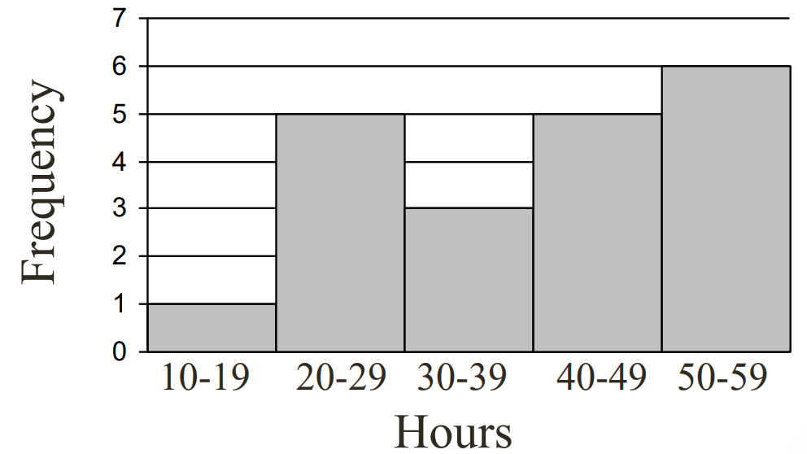
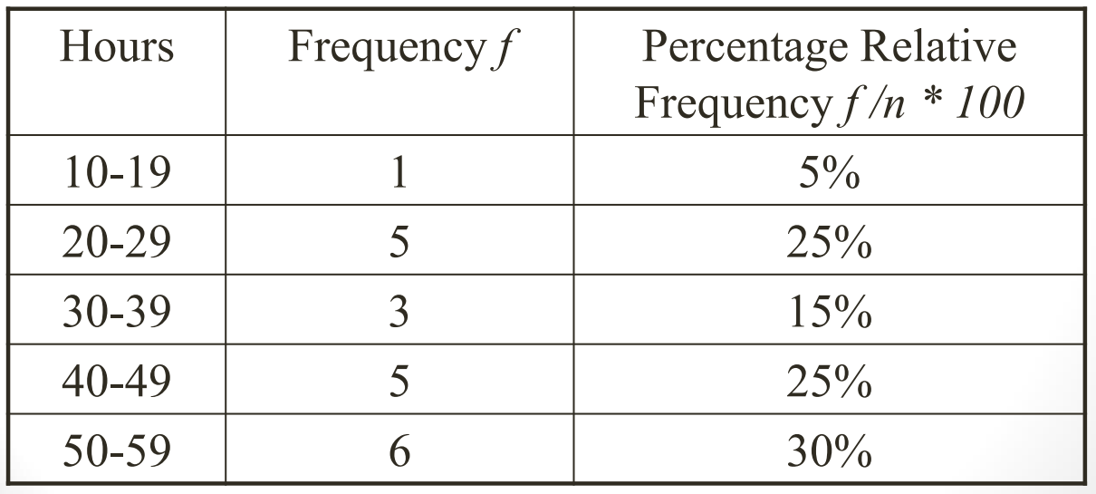
Example
Dataset: 15, 58, 37, 42, 20, 27, 36, 57, 29, 42, 51, 28, 46, 29, 58, 55, 43, 40, 56, 36

Slide 13
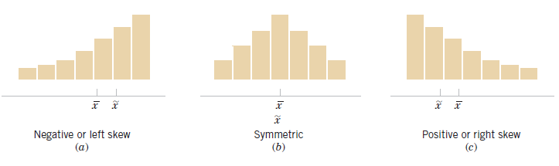
Histograms
mode > median > mean if the distribution is skewed to the left, whereas mode < median < mean if the distribution is skewed to the right

Slide 14
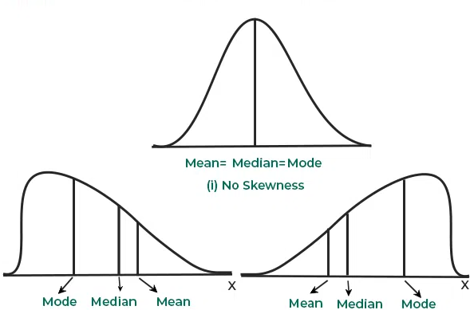
Skewness
mode > median > mean if the distribution is skewed to the left, whereas mode < median < mean if the distribution is skewed to the right

Slide 15
Skewness
Lack of symmetry is called skewness for a frequency distribution.
If the distribution is not symmetric, the frequencies will not be uniformly distributed about the center of the distribution.
Measure of skewness gives the direction and magnitude of the lack of symmetry.
Variance tells us about the amount of variability while skewness gives the direction of variability.

Slide 16

Karl Pearson’s Coefficient of Skewness
It is a relative measure of skewness.
It is most frequently used for measuring skewness.
$$S_{k}=\frac{mean−mode}{σ}$$
$$S_{k}=\frac{3(mean−median)}{σ}$$

Slide 17

Skewness
$S_{k}=0$ Perfectly Symmetric Distribution
$S_{k}>0$, Positive or right skewness
$S_{k}<0$Negative or left skewness

Slide 18
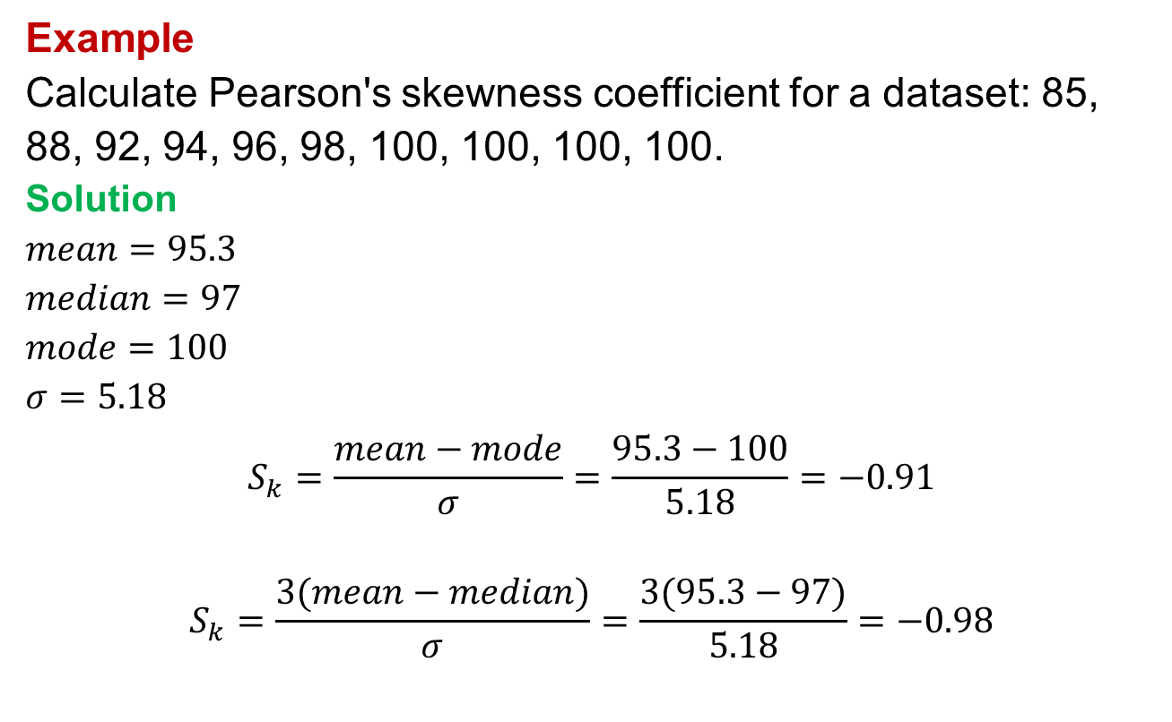
Karl Pearson’s Coefficient of Skewness
Example
Calculate Pearson's skewness coefficient for a dataset: 85, 88, 92, 94, 96, 98, 100, 100, 100, 100.
Solution
$$mean=95.3$$
$$median=97$$
$$mode=100$$
$$σ=5.18$$
$$S_{k}=\frac{mean−mode}{σ}=\frac{95.3−100}{5.18}=−0.91$$
$$S_{k}=\frac{3(mean−median)}{σ}=\frac{3(95.3−97)}{5.18}=−0.98$$

Slide 19
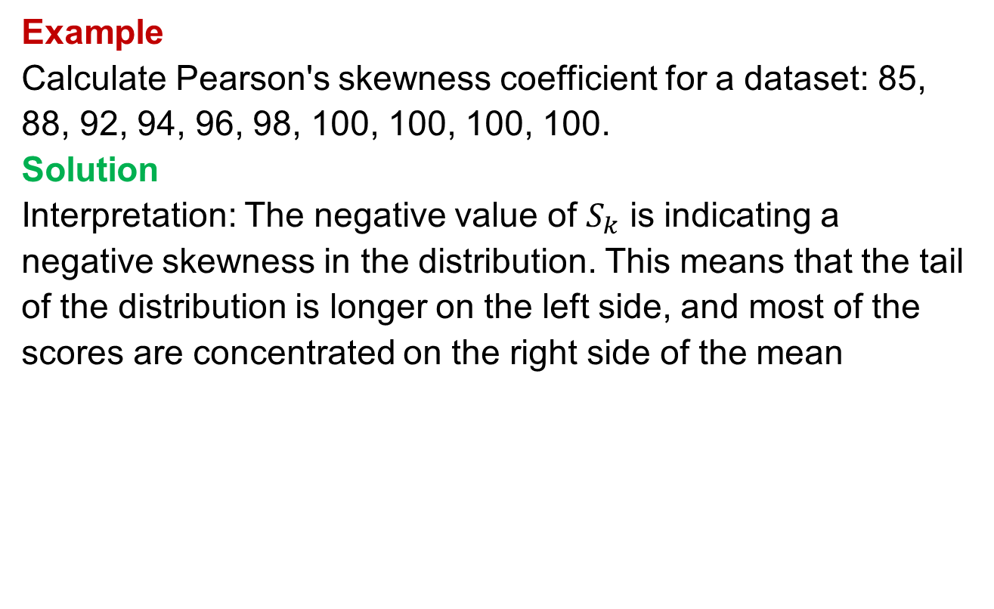
Karl Pearson’s Coefficient of Skewness
Example
Calculate Pearson's skewness coefficient for a dataset: 85, 88, 92, 94, 96, 98, 100, 100, 100, 100.
Solution
Interpretation: The negative value of $S_{k}$ is indicating a negative skewness in the distribution. This means that the tail of the distribution is longer on the left side, and most of the scores are concentrated on the right side of the mean

Slide 20
Karl Pearson’s Coefficient of Skewness
Exercise
Karl Pearson’s coefficient of skewness is 1.28, its mean is 164 and mode 100, find the standard deviation.

